Slide 1
Excel Tool for Evaulation

Slide 2
Outline
Background
User Interface
Manipulate

Slide 3
Background
Evaluation speed up
Calculate Result automatically
Intuitional Manipulate

Slide 4
User Interface
User Form
All manipulate in this sheet
Result
Open multiple files
Get Data from Each Step
Sort
Extract Necessary Data by Step Time
Graph
Get Chart/Graph

Slide 5
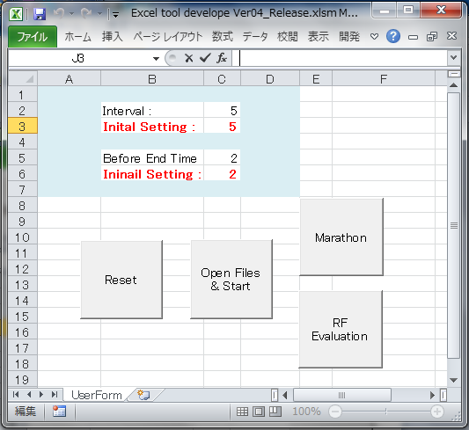
User Form
Interval
Interval Initial Setting
Before End Time
Before End Time Initial Setting
Reset Button
Open Files & Start Button
Marathon Mode Button
RF Evaluation Mode Button

Slide 6
User Form
Data is unstable before end of step
Average data in Interval in each step
Reset Button : Clean “Result”, “Sort”, “Graph” sheets
Open Files & Start Button : Build “Result” sheet
Marathon Mode Button : For Marathon summary
RF Evaluation Mode Button : For RF Evaluation summary
Before
End Time
Interval
Step 1
Step 2
Step 3

Slide 7
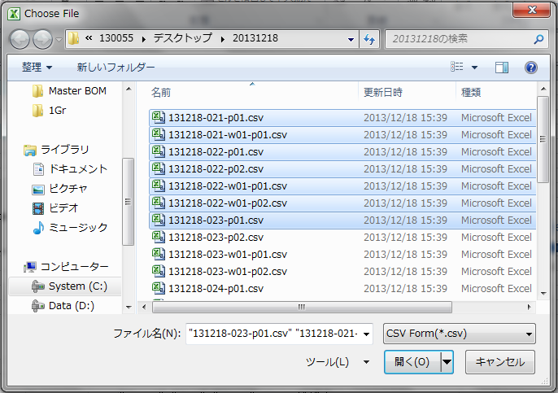
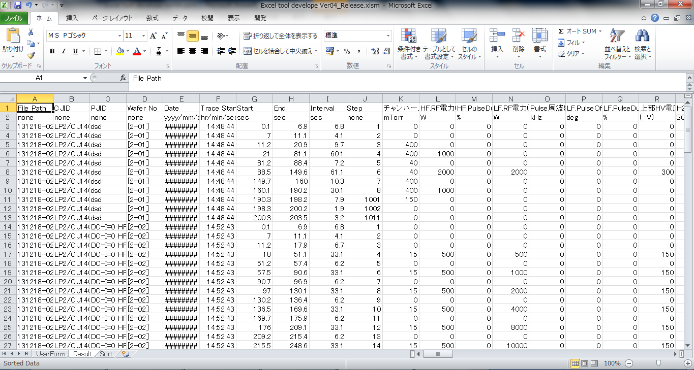
Open Files
Open Multiple files
Get average in each step interval

Slide 8
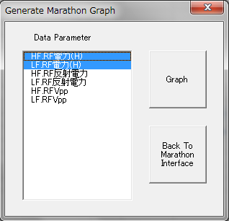
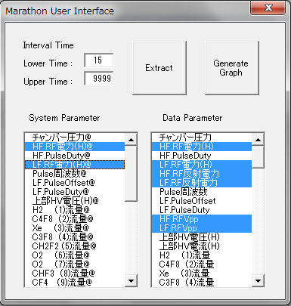
Marathon Mode
Extract necessary data in “Sort” sheet
Build RK map in “Graph” sheet
UI Switch

Slide 9
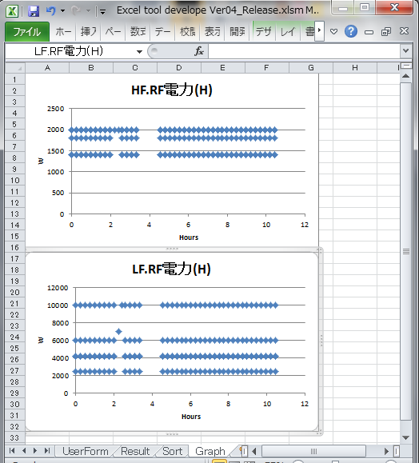
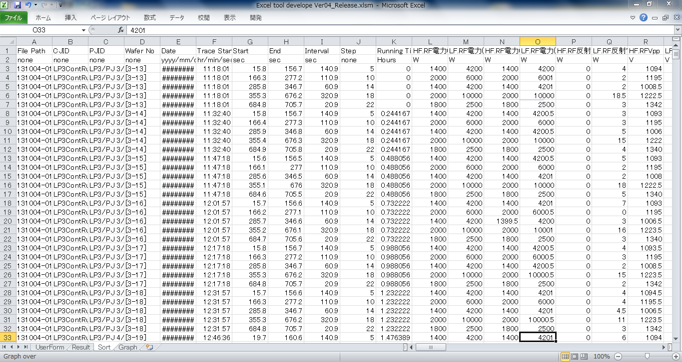
Marathon Mode
Marathon Sort
Marathon Graph

Slide 10
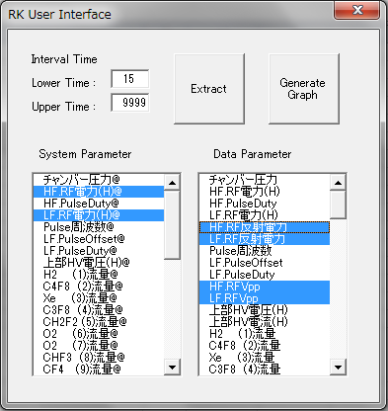
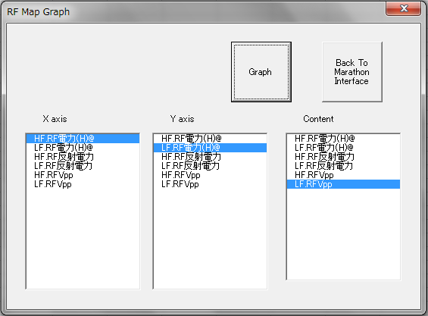
RF Evaluation Mode
Extract necessary data in “Sort” sheet
Build RK map in “Graph” sheet
User Interface Switch

Slide 11
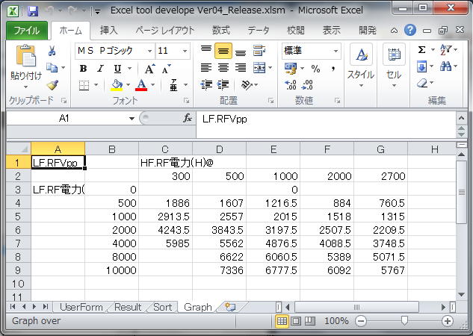
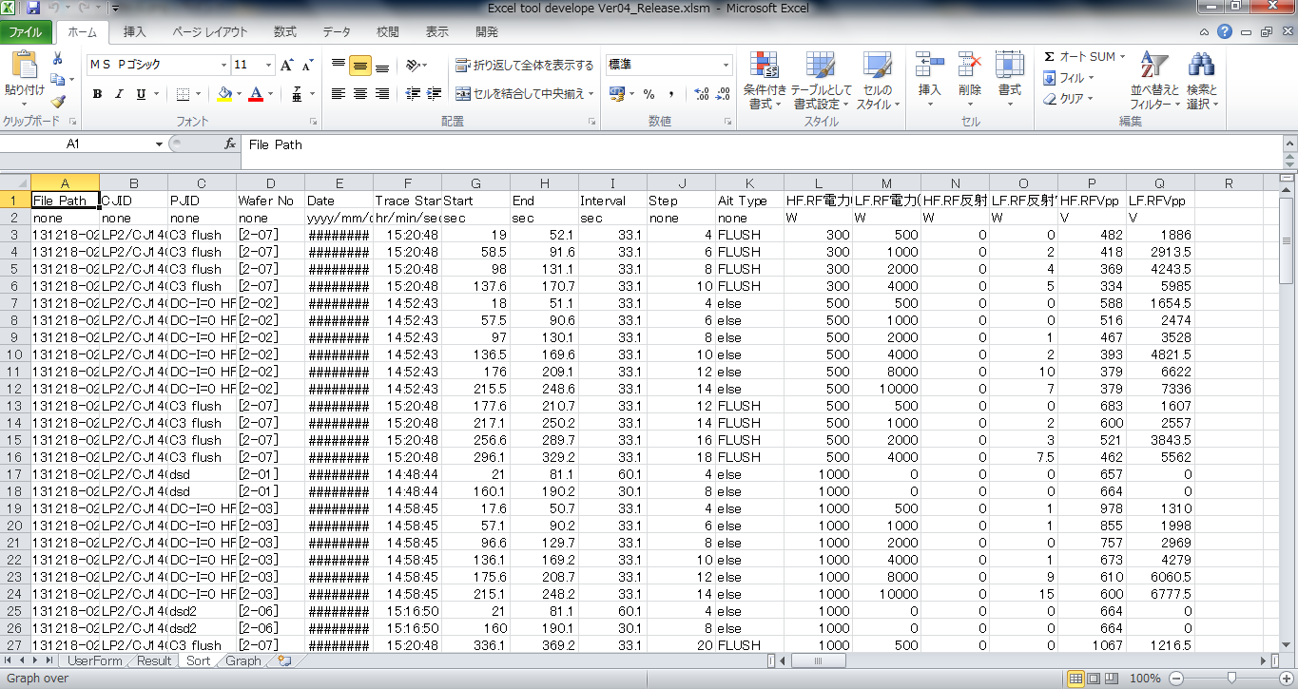
RF Evaluation Mode
RK Sort
RK Graph

Slide 12
RF Ⅴ
Extract
Graph
Reset
Open Files
Marathon ｃ
Extract
Graph

